Slide 1
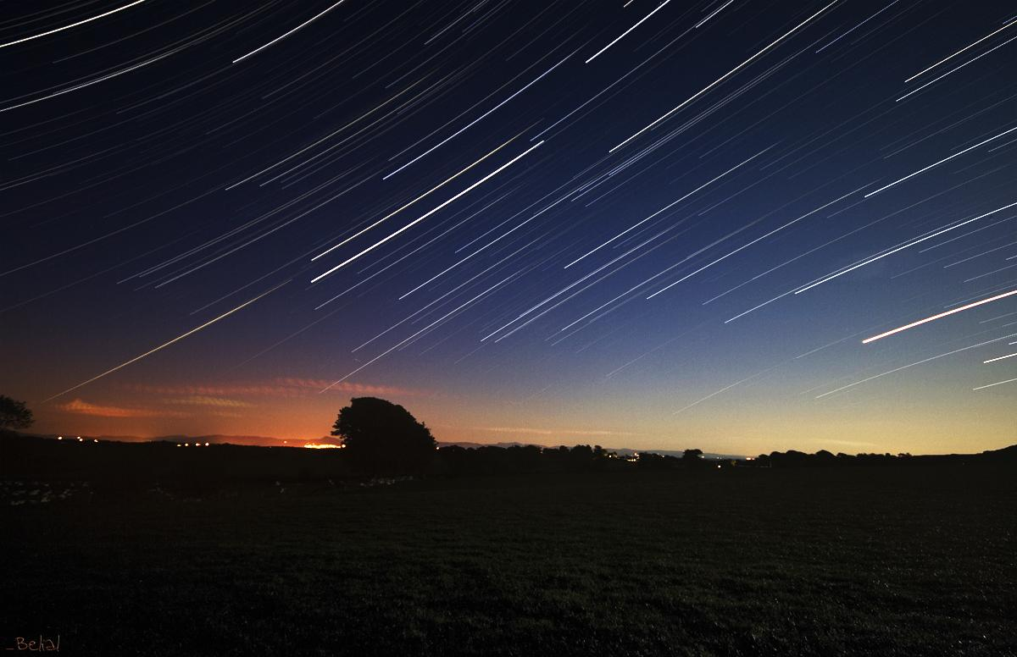
UbiZen
http://www.flickr.com/photos/17149966@N00/521278577/
Estudos em Jogos Ubíquos
Por Fabricio Nogueira Buzeto
www.unbiquitous.org

Slide 2

http://www.flickr.com/photos/18382722@N00/87431231/

Slide 3
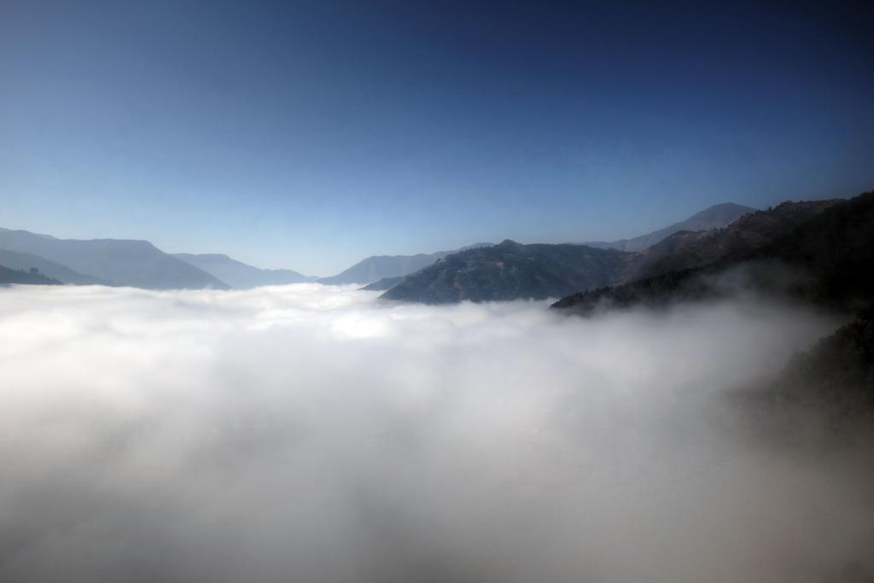






1451

Slide 4
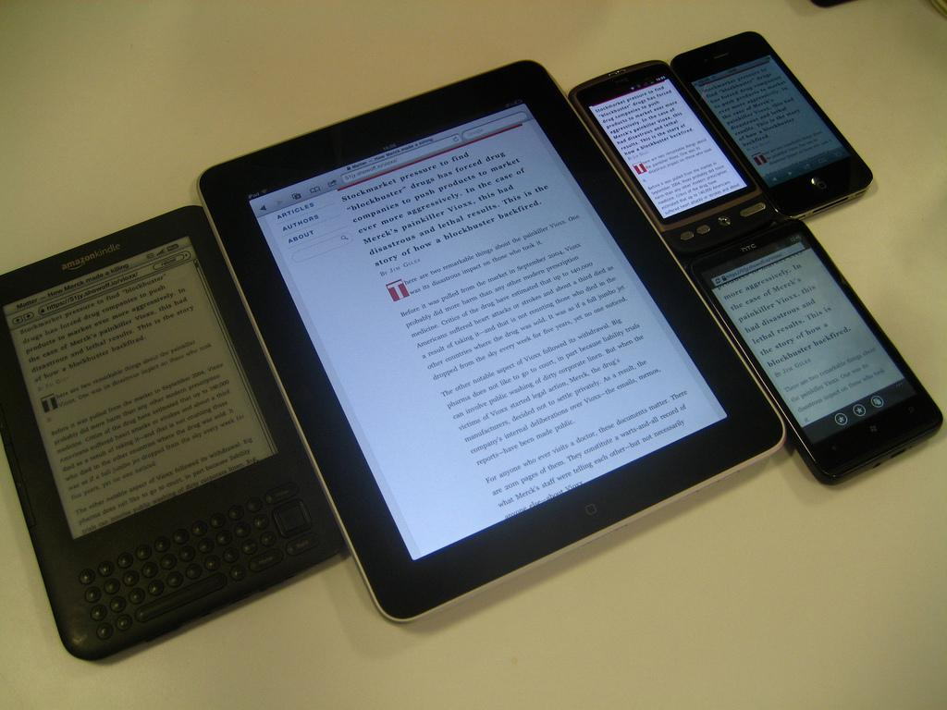







Slide 5

Aplicação
http://www.flickr.com/photos/44718043@N06/4224085160/

Slide 6
Aplicação
Aplicação
Aplicação
Aplicação
Aplicação
http://www.flickr.com/photos/44718043@N06/4224085160/

Slide 7
Aplicação
Conversor
App
App
App
App
App
http://www.flickr.com/photos/44718043@N06/4224085160/

Slide 8
Aplicação
App
App
App
App
App
http://www.flickr.com/photos/44718043@N06/4224085160/

Slide 9

"Middleware is a distributed-system software that resides between applications and underlying platforms (operating systems; databases; hardware), and/or ties together distributed applications, databases or devices. Its primary role is to coordinate and enable communication between different layers or components while isolating
much of the complexity
of distribution into a single,
well tested and well understood
system abstraction."
http://www.flickr.com/photos/44718043@N06/4224085160/

Slide 10
Aplicação
App
App
App
App
App
Middleware
Middleware
Middleware
Middleware
Middleware
http://www.flickr.com/photos/44718043@N06/4224085160/

Slide 11

Aplicação
Middleware
Middleware
S.O.
S.O.
Hardware
Hardware
http://www.flickr.com/photos/20375052@N00/5408800/

Slide 12
Aplicação
Middleware
Middleware
S.O.
S.O.
Hardware
Hardware
http://www.flickr.com/photos/20375052@N00/5408800/

Slide 13

Modelo
Suporte
"http://www.flickr.com/photos/51035555243@N01/26006138/

Slide 14
Modelo
Interação Operacional
Suporte
"http://www.flickr.com/photos/51035555243@N01/26006138/

Slide 15
Modelo
Interação Operacional
Interação Remota
Suporte
"http://www.flickr.com/photos/51035555243@N01/26006138/

Slide 16
Modelo
Interação Operacional
Interação Remota
Distribuição Transparente
Suporte
"http://www.flickr.com/photos/51035555243@N01/26006138/

Slide 17
Modelo
Interação Operacional
Interação Remota
Distribuição Transparente
Independencia Tecnológica
Suporte
"http://www.flickr.com/photos/51035555243@N01/26006138/

Slide 18
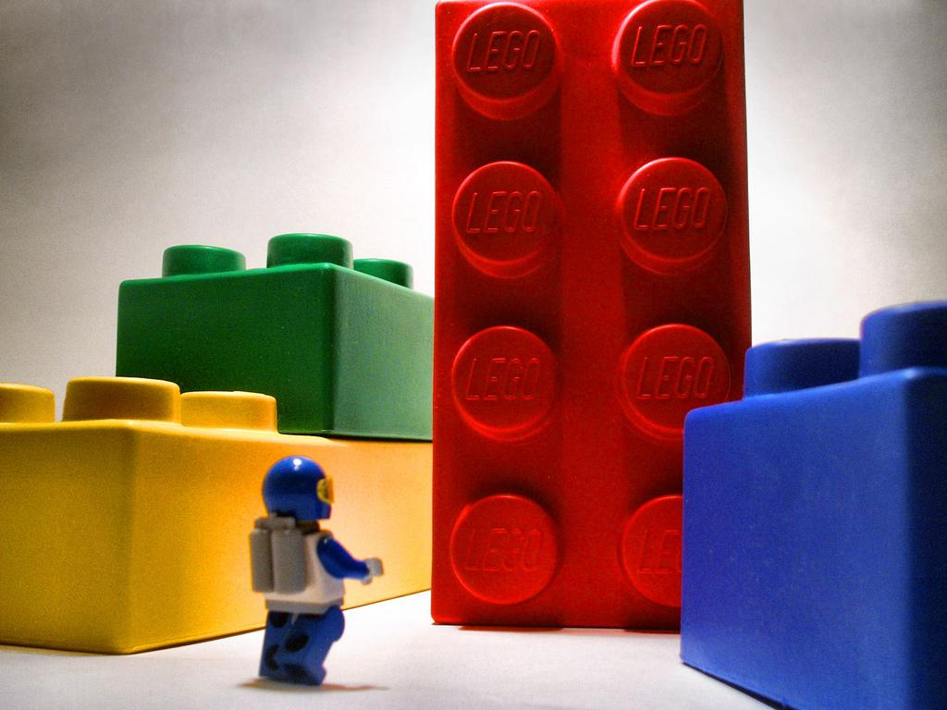
Partes
Linguagem de Programação
Sistema Operacional
Arquitetura do Computador
Redes de Comunicação
http://www.flickr.com/photos/60648084@N00/2136923757

Slide 19
Aplicações
Framework / API
Coordenador de Aplicações
Núcleo de Gestão
Middleware
Coordenador de Recursos
Coordenador de Comunicação
Plataforma

Slide 20
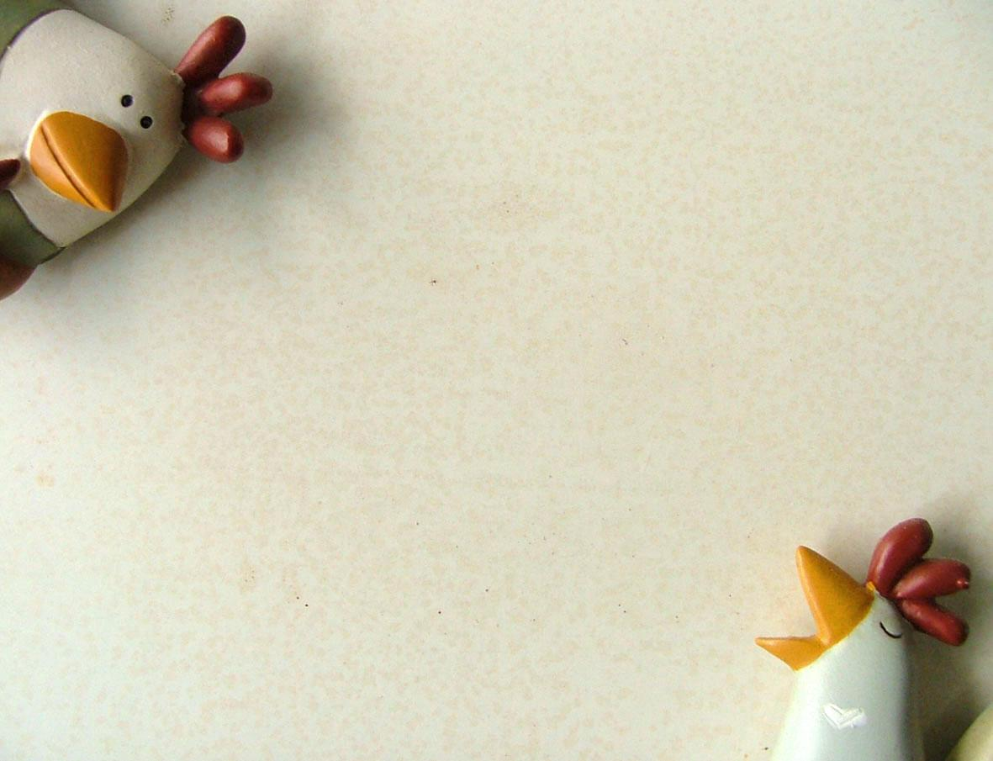
Serviços
Entregue
http://www.flickr.com/photos/56597995@N00/88536167/

Slide 21
Serviços
Eventos
Entregue
http://www.flickr.com/photos/56597995@N00/88536167/

Slide 22
Serviços
Eventos
Entregue
Streaming
http://www.flickr.com/photos/56597995@N00/88536167/

Slide 23
Serviços
Eventos
Entregue
Streaming
Categorização de Dispositivos
http://www.flickr.com/photos/56597995@N00/88536167/

Slide 24
Serviços
Eventos
Entregue
Streaming
Categorização de Dispositivos
Centralizado
P2P
http://www.flickr.com/photos/56597995@N00/88536167/

Slide 25
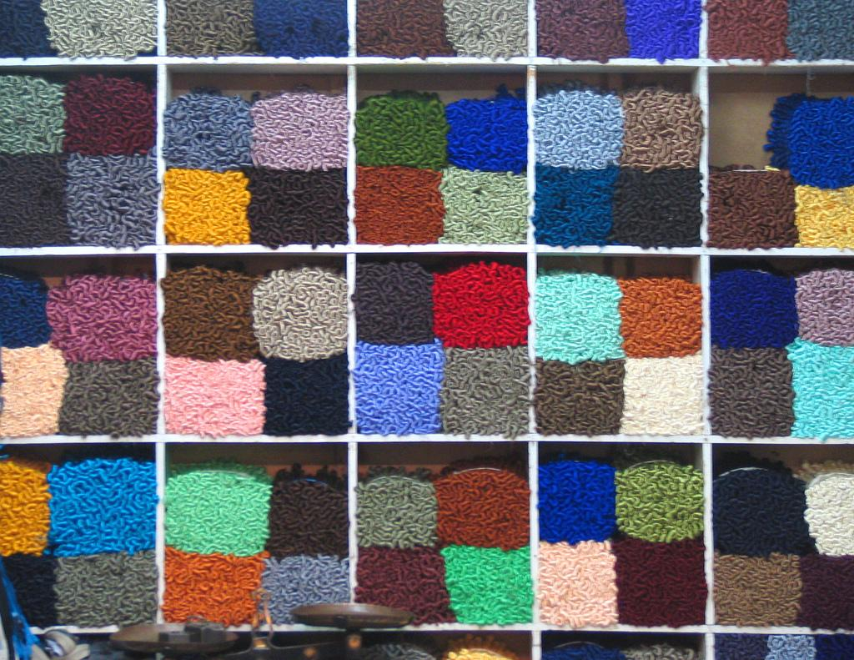
Middlewares
na
Ubicomp
Middlewares
na
Ubicomp
"http://www.flickr.com/photos/8558514@N07/520472760/

Slide 26
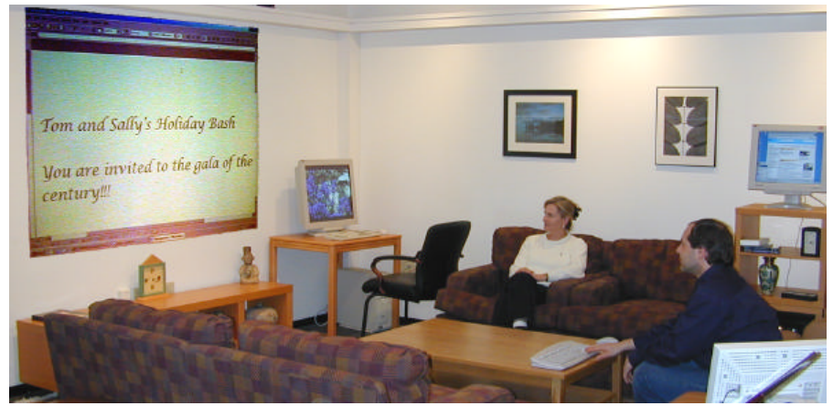
InConcert

Slide 27
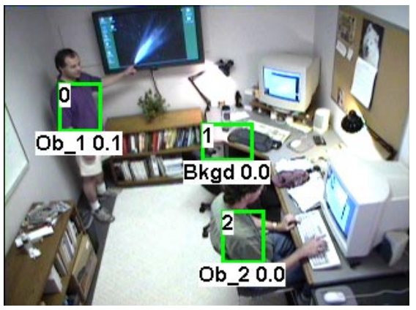

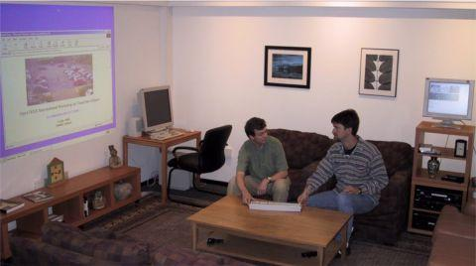
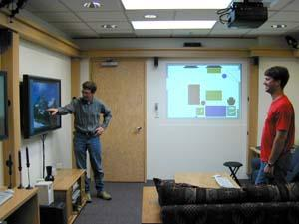

Slide 28



Aura
----------
----------
----

Slide 29

----------
----------
----

Slide 30
----------
----------
----

Slide 31
----------
----------
----

Slide 32




T
---------
Aura
Prisma
T
---------
T
---------

Slide 33
GaiaOS
MPACC

Slide 34
Presentation
Model
Appication
Coordinator
GaiaOS
Device
Adapter
Controller

Slide 35
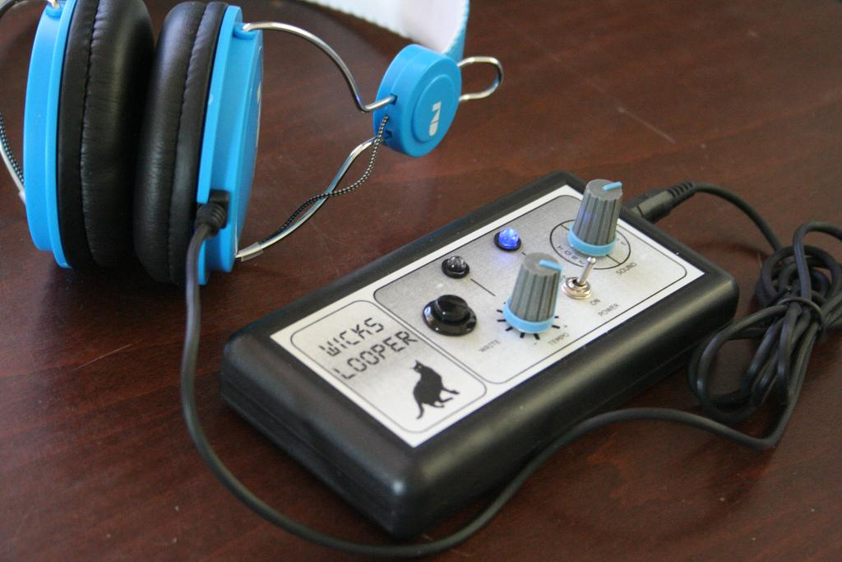
VESPER
VHE
http://www.flickr.com/photos/14898247@N04/5278868351

Slide 36


Slide 37


Slide 38


Slide 39

A

Slide 40
A

Slide 41
A
P

Slide 42
P
A

Slide 43
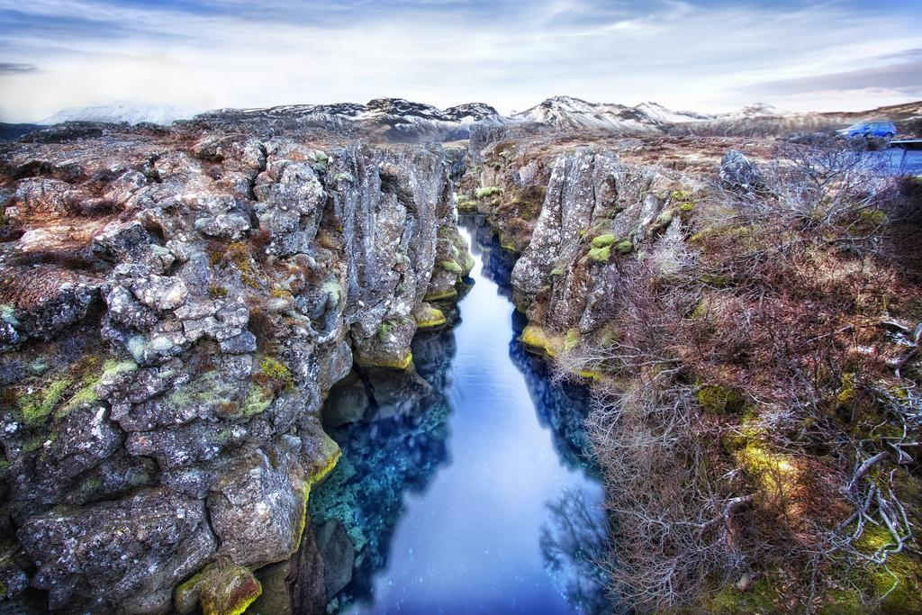
MediaBroker
Streams

Slide 44

?

Slide 46


?

Slide 49
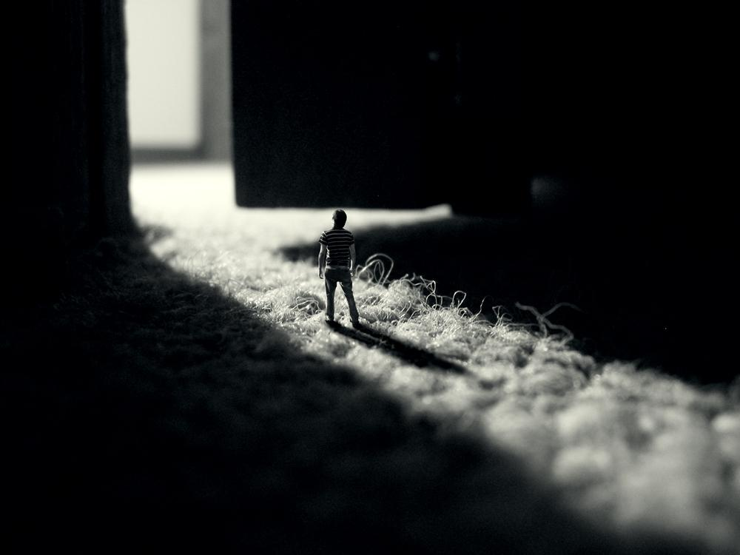
MundoCore
Objetos Distribuídos
"http://www.flickr.com/photos/14127431@N00/40786131/

Slide 50
ME

Slide 51
US
US
US
US
ME
US
US
ME

Slide 52
IT
IT
US
US
US
US
ME
US
US
ME
WE

Slide 53
IT
IT
US
US
US
US
ME
US
US
ME
WE

Slide 54
IT
IT
US
US
US
US
ME
US
THEY
US
ME
WE

Slide 55
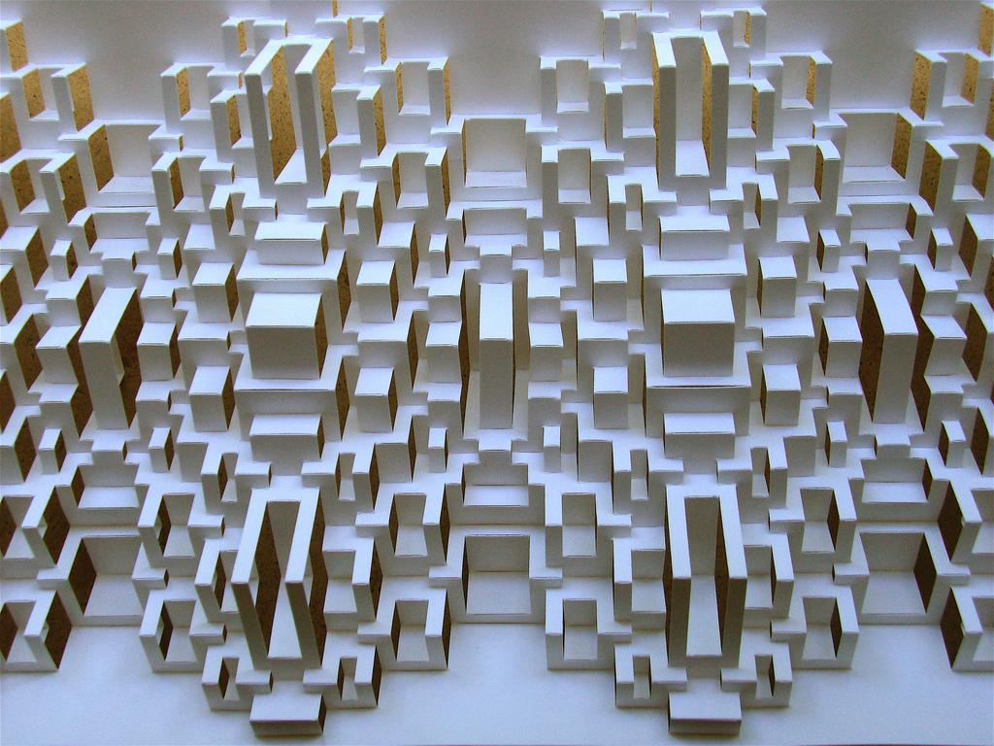
MoCA
Eventos
http://www.flickr.com/photos/38838670@N08/4796155733/

Slide 56
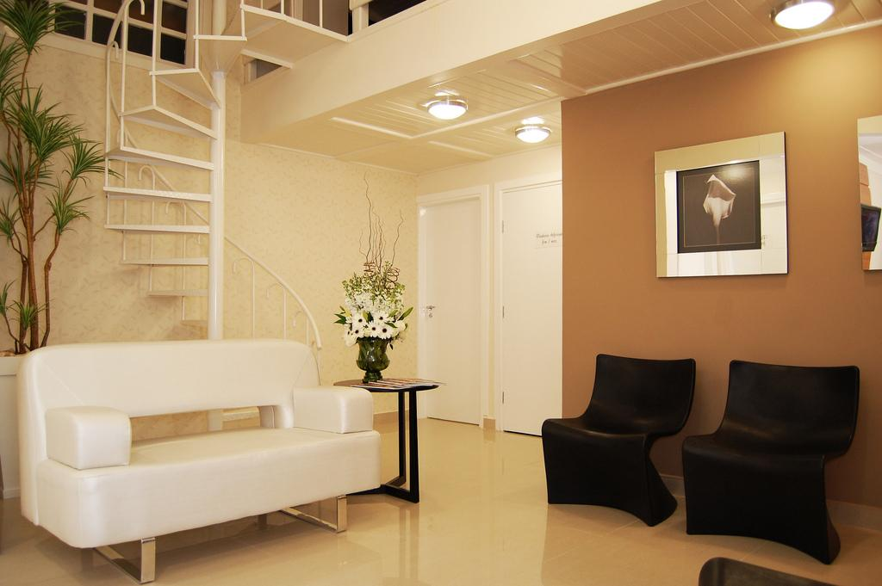
Gathor Tech
Smart House
http://www.flickr.com/photos/27584532@N03/4730969275/

Slide 57
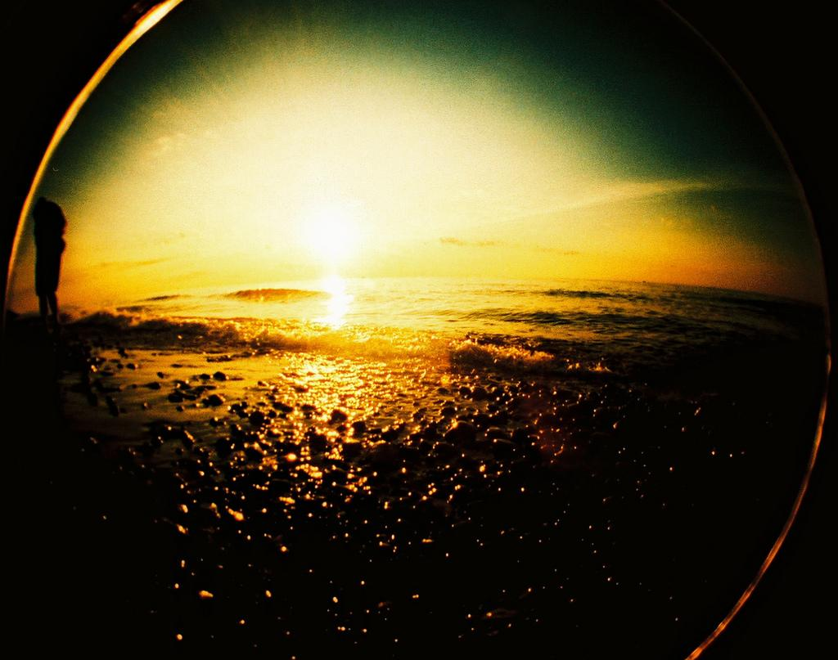
WSAMI
Home SOA
SATIN
Mico
Outros
E-Sense
Hydra

Slide 58

http://www.flickr.com/photos/wallyg/

Slide 59

http://www.flickr.com/photos/sylvain_masson/
Fabricio Nogueira
Buzeto
UbiZen Games
Tarefa
O que é útil ao seu jogo?

